Slide 1


Python 求解一阶波动方程
$$\frac{∂U}{∂t}+c\frac{∂U}{∂x}=0$$
Xin Li, Zhiyuan Zheng, Junbao Ni

Slide 2
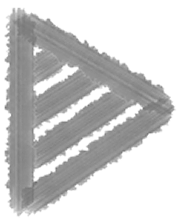
Analytical Solution:
$$f(x+ct)+f(x-ct)$$
欧拉网格
$$U(x,t)$$
Up-wind
Lax-Friedrichs
Lax-Wendroff
Hopscotch
Full implicit
Crack-Nicholson
初始条件
边界条件
时间步长
空间步长
稳定性条件
$$U(x,t_{i})=f(x)|_{t=t_{i}}$$
左边界
$$U(x_{l},t)=f(t)|_{x=x_{l}}$$
右边界
$$U(x_{r},t)=f(t)|_{x=x_{r}}$$
$$dt$$
$$dx$$
$$r=c\frac{dt}{dx}$$

Slide 3
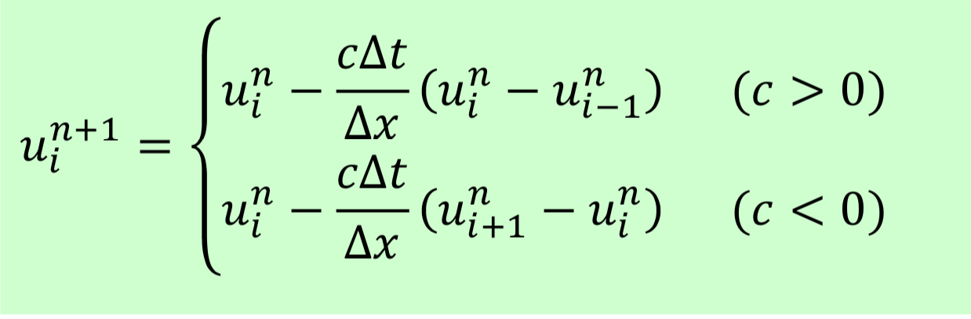
Code display
U[space,time]
Up-wind
def upwind(r,X,T,U_init,U_left):
U = np.zeros((len(X),len(T)))
U[:,0] = U_init
U[0,:] = U_left
for n in np.arange(len(T)-1):
U[1:, n+1] = U[1:, n] - r*(U[1:, n] - U[0:-1,n])
return U

Slide 4
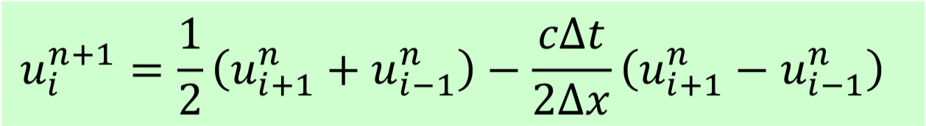
Lax-Friedrichs
def Lax_Friedrichs(r,X,T,U_init,U_left,U_right):
U = np.zeros((len(X),len(T)))
U[:,0] = U_init
U[0,:] = U_left
U[-1,:]= U_right
for n in np.arange(len(T)-1):
U[1:-1,n+1] = 0.5*(U[2:,n]+U[:-2,n])-0.5*r*(U[2:,n]-U[:-2,n])
return U

Slide 5
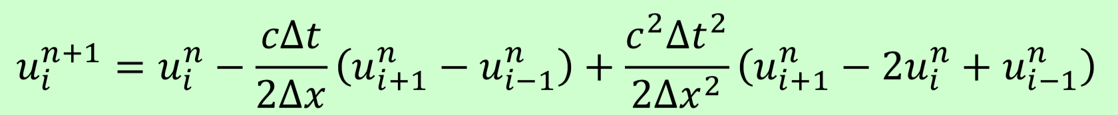
Lax-Wendroff
def Lax_Wendroff(r,X,T,U_init,U_left,U_right):
U = np.zeros((len(X),len(T)))
U[:,0] = U_init
U[0,:] = U_left
U[-1,:]= U_right
for n in np.arange(len(T)-1):
U[1:-1,n+1]=U[1:-1,n]-0.5*r*(U[2:,n]-U[:-2,n]+0.5*r**2*(U[2:,n]- 2*U[1:-1,n]+U[:-2,n])
return U

Slide 6
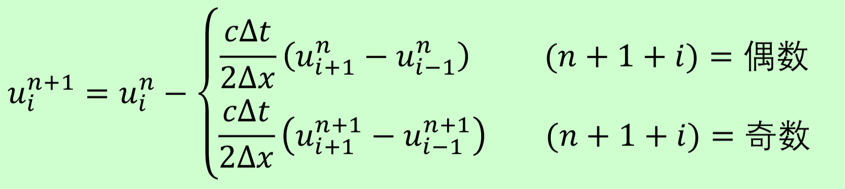
Hopscotch
def hopscotch(r,X,T,U_init,U_left,U_right):
U = np.zeros((len(X),len(T)))
U[:,0] = U_init
U[0,:] = U_left
U[-1,:] = U_right
for n in np.arange(len(T)-1):
for i in np.arange(len(X)-2):
if (n+i+1)%2==0:
U[i+1,n+1] = U[i+1,n]-0.5*r*(U[i+2,n]-U[i,n])
for i in np.arange(len(X)-2):
if (n+i+1)%2!=0:
U[i+1,n+1] = U[i+1,n]-0.5*r*(U[i+2,n+1]-U[i,n+1])
return U

Slide 7
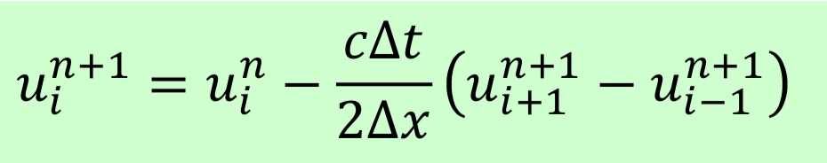
def Thomas(La, Mb, Uc, b):
"""
Arguments:
La -- [lower item for tri-diagonal matrix]
Mb -- [mian item for tri-diagonal matrix]
Uc -- [upper item for tri-diagonal matrix]
b -- [AX = b, where A is the tri-diagonal matrix]
"""
n = len(Mb)
Uc[0] = Uc[0] / Mb[0]
for i in range(1, n-1):
Uc[i] = Uc[i] / (Mb[i] - La[i - 1] * Uc[i - 1])
b[0] = b[0] / Mb[0]
for i in range(1, n):
b[i] = (b[i] - La[i-1]*b[i-1]) / (Mb[i] - La[i-1] * Uc[i-1])
ls = list(range(n-1))[::-1]
for i in ls:
b[i] = b[i] - Uc[i]*b[i+1]
return np.array(b)
Full implicate
def full_implicate(r,X,T,U_init,U_left,U_right):
U = np.zeros((len(X),len(T)))
U[:,0] = U_init
U[0,:] = U_left
U[-1,:]= U_right
for n in range(len(T)-1):
a = -0.5*r*np.ones((len(X)-3))的值
b = np.ones((len(X)-2))
C = 0.5*r*np.ones((len(X)-3))
k = []
for i in range(len(X)-2):
k.append(U[i+1,n])
k[0] += 0.5*r*U[0,n+1]
k[-1] -= 0.5*r*U[-1,n+1]
U[1:-1,n+1] = Thomas(a,b,C,k)
return U

Slide 8
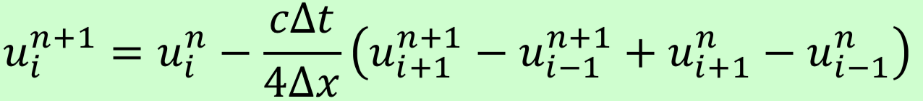
def Thomas(La, Mb, Uc, b):
"""
Arguments:
La -- [lower item for tri-diagonal matrix]
Mb -- [mian item for tri-diagonal matrix]
Uc -- [upper item for tri-diagonal matrix]
b -- [AX = b, where A is the tri-diagonal matrix]
"""
n = len(Mb)
Uc[0] = Uc[0] / Mb[0]
for i in range(1, n-1):
Uc[i] = Uc[i] / (Mb[i] - La[i - 1] * Uc[i - 1])
b[0] = b[0] / Mb[0]
for i in range(1, n):
b[i] = (b[i] - La[i-1]*b[i-1]) / (Mb[i] - La[i-1] * Uc[i-1])
ls = list(range(n-1))[::-1]
for i in ls:
b[i] = b[i] - Uc[i]*b[i+1]
return np.array(b)
Crack Nicholson
def Crack_Nicholson(r,X,T,U_init,U_left,U_right):
U = np.zeros((len(X),len(T)))
U[:,0] = U_init
U[0,:] = U_left
U[-1,:]= U_right
for n in range(len(T)-1):
a = -0.25*r*np.ones((len(X)-3))
b = np.ones((len(X)-2))
C = 0.25*r*np.ones((len(X)-3))
k = []
for i in range(len(X)-2):
k.append(U[i+1,n]-0.25*r*(U[i+2,n]- U[i,n]))
k[0] += 0.25*r*U[ 0,n+1]
k[-1] -= 0.25*r*U[-1,n+1]
U[1:-1,n+1] = Thomas(a,b,C,k)
return U

Slide 9
Case1
$$U(x,t)=f(x-ct)=sin(2π(x-ct))$$
初始条件
$$U(x,0)=f(x)=sin(2πx)$$
$$U(x_{l},t)=f(x_{l}-ct)=sin(2π(x_{l}-ct))$$
边界条件
$$U(x_{r},t)=f(x_{r}-ct)=sin(2π(x_{r}-ct))$$
$$[t_{i},t_{f}]=[0,10]$$
$$dt=0.05$$
$$T=np.arange(t_{i},t_{f}+dt,dt)$$
$$[x_{l},x_{r}]=[0,10]$$
$$dx=0.1$$
$$X=np.arange(x_{l},x_{r}+dx,dx)$$
$$r=c\frac{dt}{dx}=0.5<1$$
$$c=1$$

Slide 10
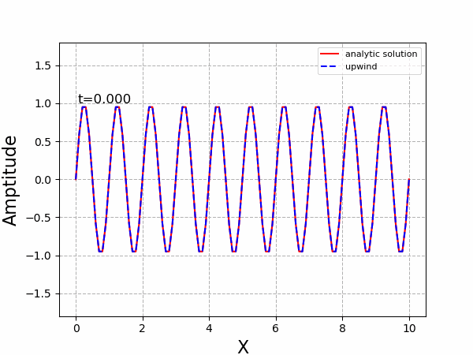
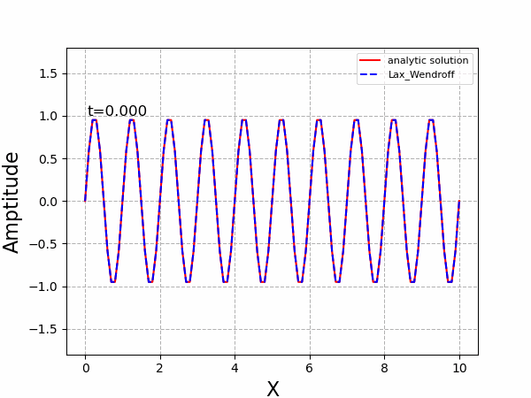




Up-wind
Lax-Wendroff
Lax-Friedrichs
Hopscotch
Full implicate
Crack Nicholson

Slide 11
Up-wind
Lax-Wendroff
Lax-Friedrichs
Hopscotch
Full implicate
Crack Nicholson

Slide 12
Case2
$$r=1$$
$$[t_{i},t_{f}]=[0,10]$$
$$dt=0.1$$
$$T=np.arange(t_{i},t_{f}+dt,dt)$$
$$[x_{l},x_{r}]=[0,10]$$
$$dx=0.1$$
$$X=np.arange(x_{l},x_{r}+dx,dx)$$
$$r=c\frac{dt}{dx}=1$$
$$c=1$$

Slide 13
Up-wind
Lax-Wendroff
Lax-Friedrichs
Hopscotch
Full implicate
Crack Nicholson

Slide 14
Case3
$$r>1$$
$$[t_{i},t_{f}]=[0,10]$$
$$dt=0.2$$
$$T=np.arange(t_{i},t_{f}+dt,dt)$$
$$[x_{l},x_{r}]=[0,10]$$
$$dx=0.1$$
$$X=np.arange(x_{l},x_{r}+dx,dx)$$
$$r=c\frac{dt}{dx}=2>1$$
$$c=1$$

Slide 15
Up-wind
Lax-Wendroff
Lax-Friedrichs
Hopscotch
Full implicate
Crack Nicholson

Slide 16
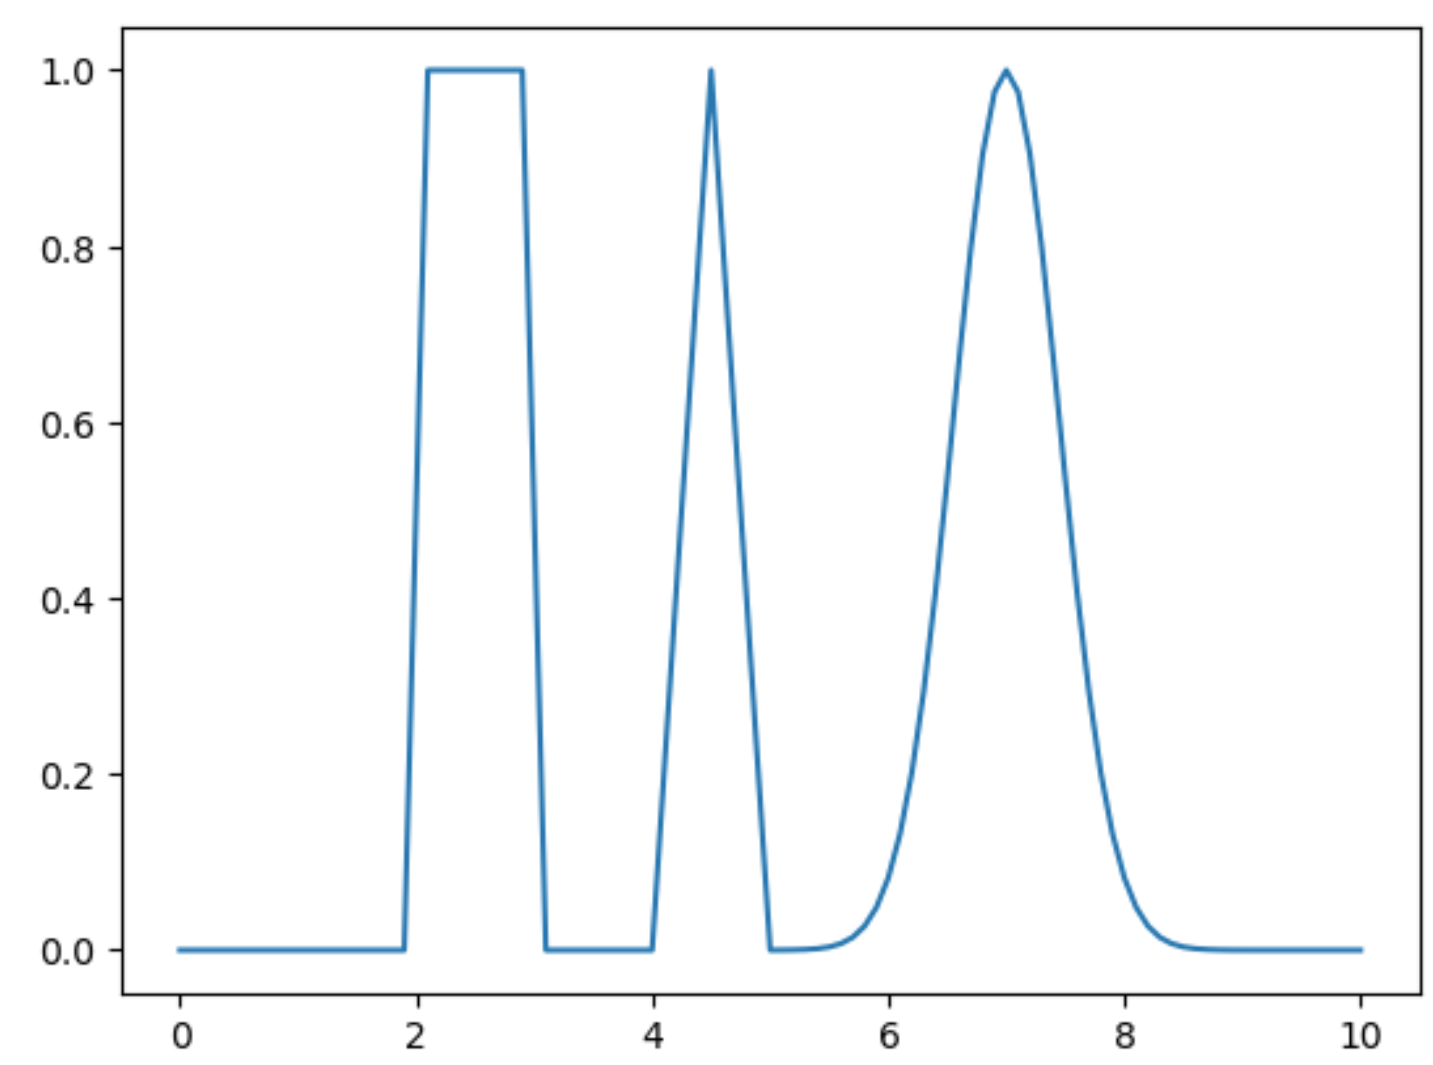
Case4
$$U(x,t)=f(x-ct)=exp\{\frac{-(x-ct-7)^{2}}{0.4}\}$$
$$+Heaviside(x-ct-2,0.5)×Heaviside(-(x-ct-3),0.5)$$
$$+min(max(x-ct-4,0),max(-(x-ct-5),0))×2$$
$$[t_{i},t_{f}]=[0,10]$$
$$[x_{l},x_{r}]=[0,10]$$
$$dt=0.05$$
$$dx=0.1$$
$$c=1$$
$$T=np.arange(t_{i},t_{f}+dt,dt)$$
$$X=np.arange(x_{l},x_{r}+dx,dx)$$
$$r=c\frac{dt}{dx}=0.5<1$$

Slide 17
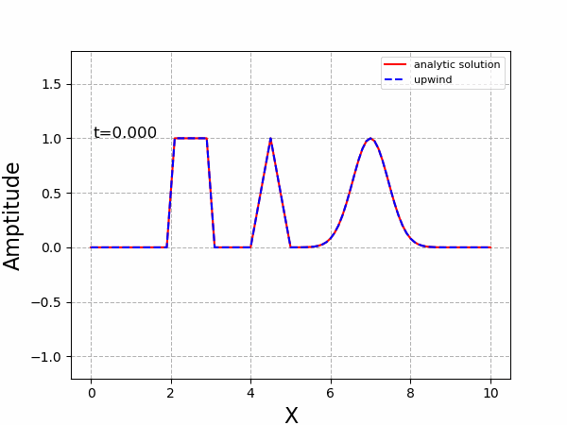
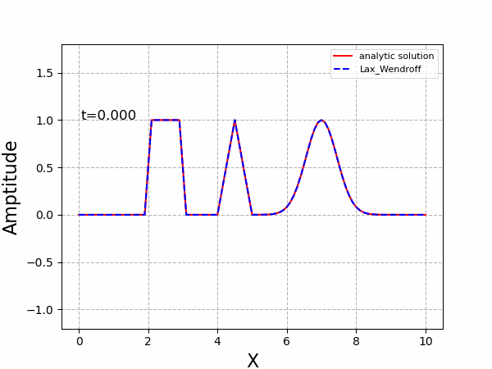

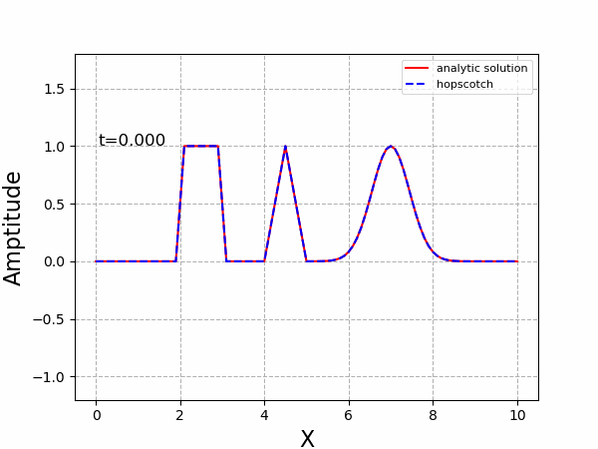

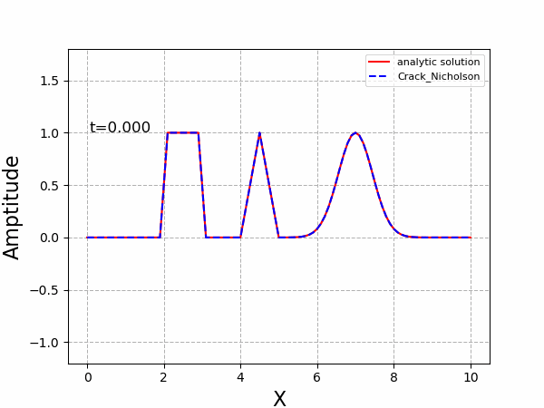
Up-wind
Lax-Wendroff
Lax-Friedrichs
Hopscotch
Full implicate
Crack Nicholson

Slide 18
Up-wind
Lax-Wendroff
Lax-Friedrichs
Hopscotch
Full implicate
Crack Nicholson

